Slide 1
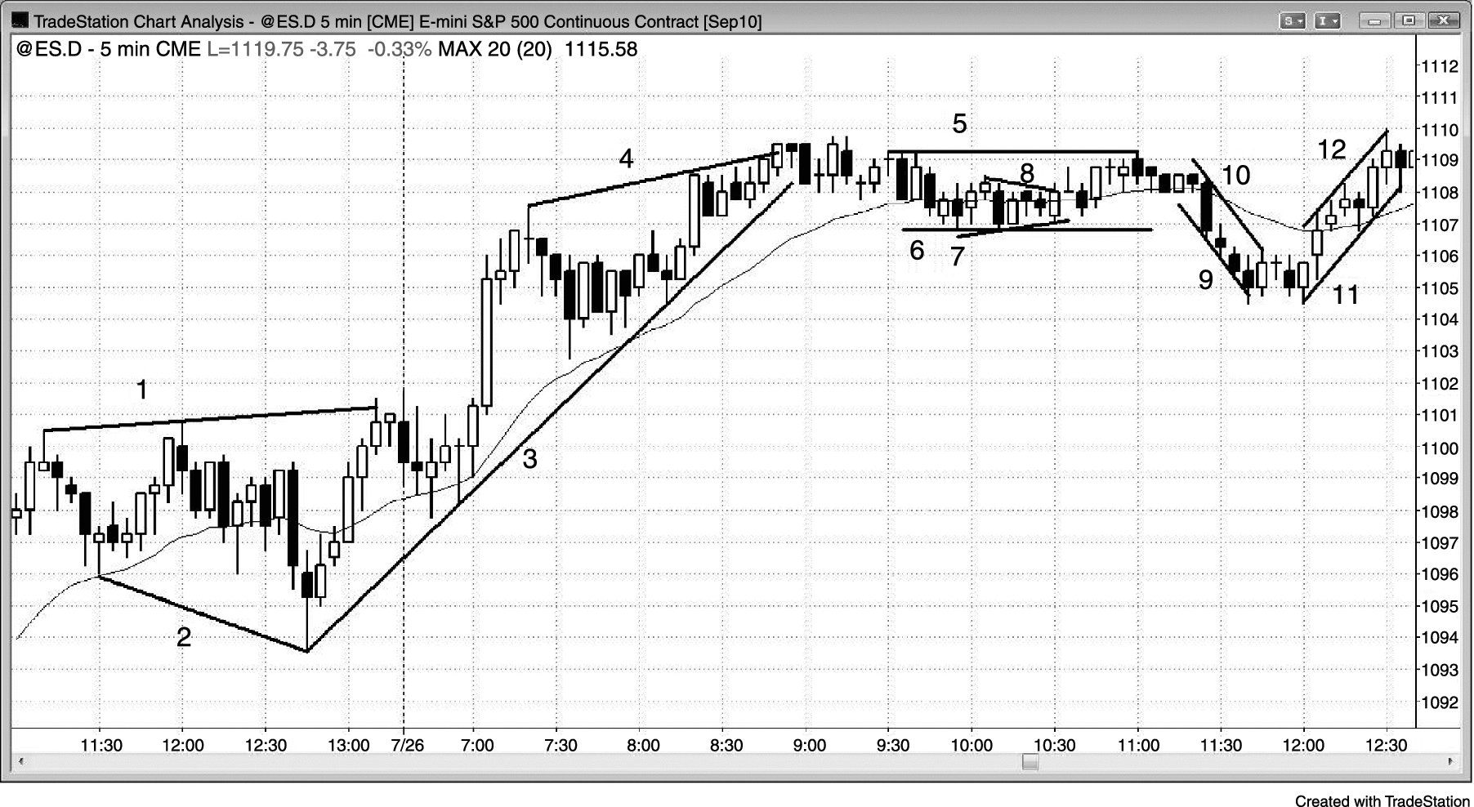
FIGURE PII.1 Lines Highlight Trends

